Slide 1
Graph Project - Team 5
Karina Elias, Juan Hernandez Diaz, & Alfredo Hernandez Jr

Slide 2
What did we make?
We made a game
Enemies use a Graph for movement
Enemies move after the player moves
Player has to reach a goal without being touched.

Slide 3
How we practiced Scrum
We made small goals in our first meeting.
Split up the workload as evenly as possible.
Gave feedback and solved problems together.

Slide 4
Challenges!
Little practice making JUnit tests
Making time during the semester
Conflicting ideas in implementation

Slide 5
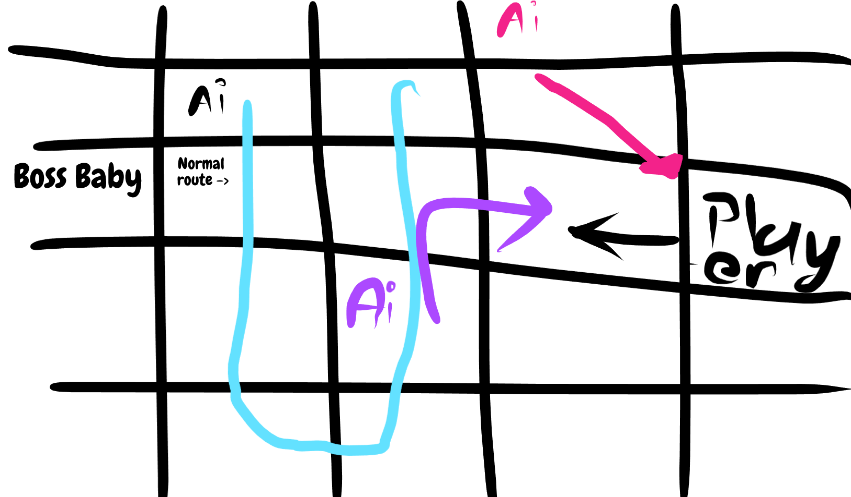
Idea phase
aa

Slide 6
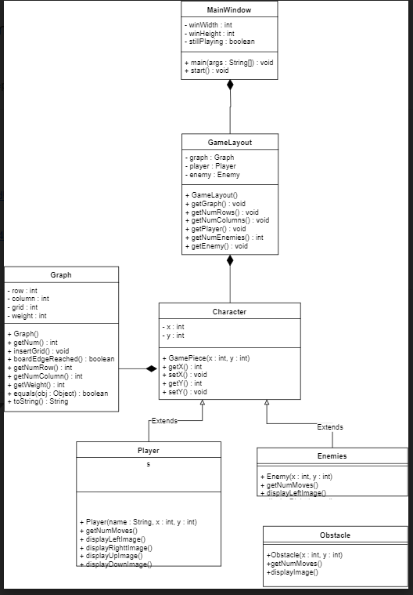
Early UML

Slide 7
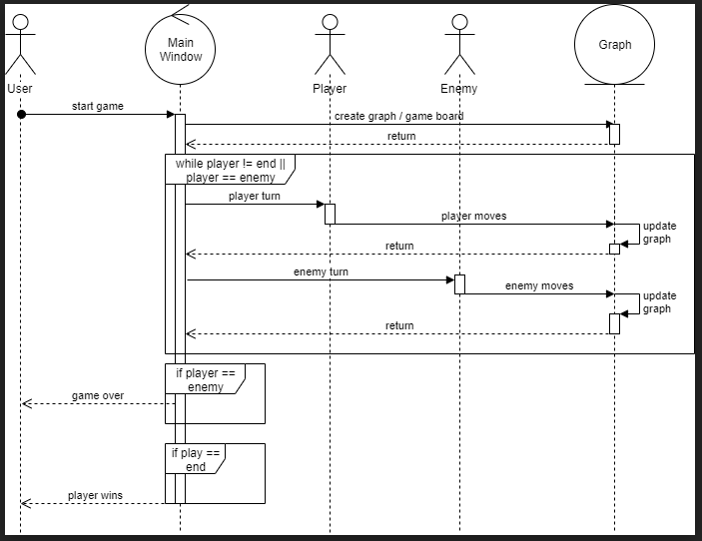
Sequence Diagram

Slide 8
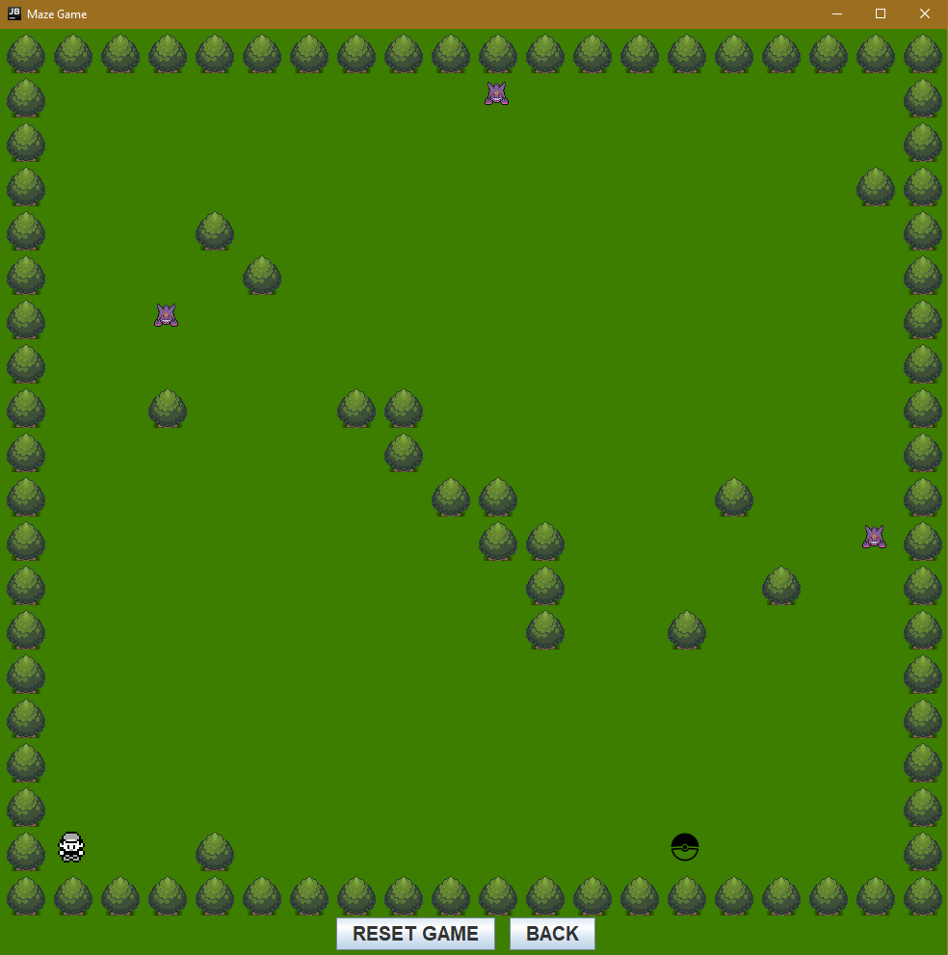
How to play

Slide 9
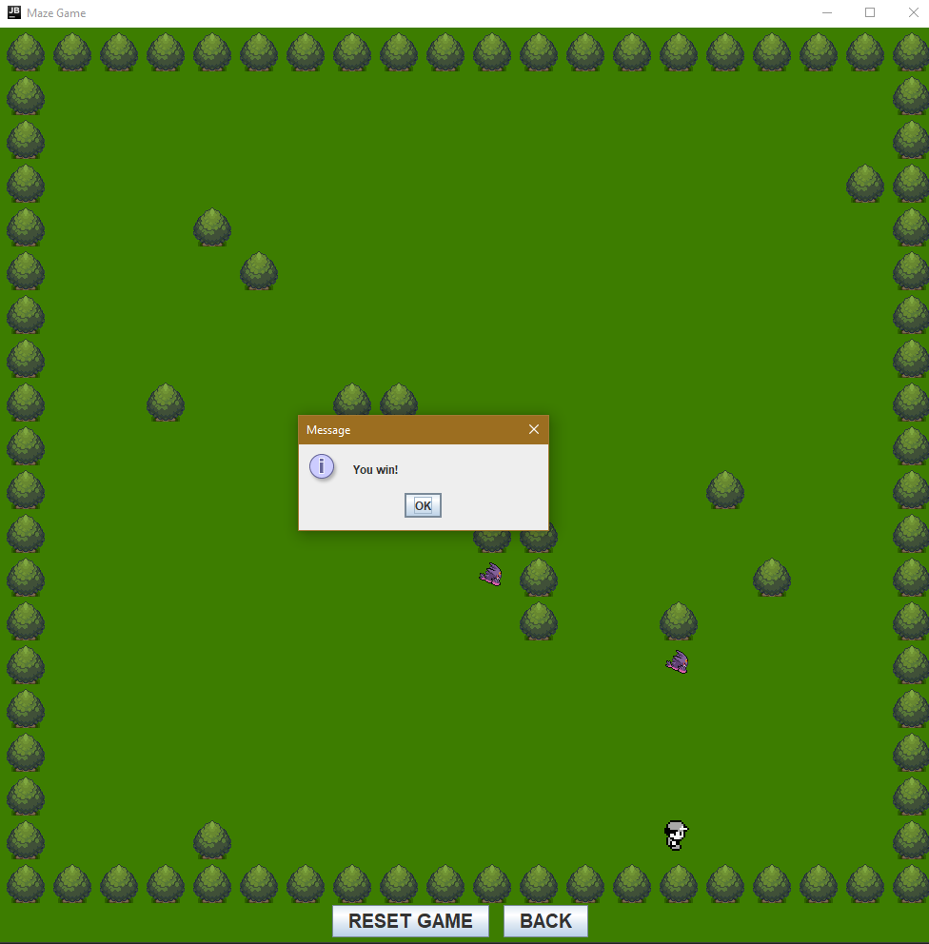
How to win

Slide 10
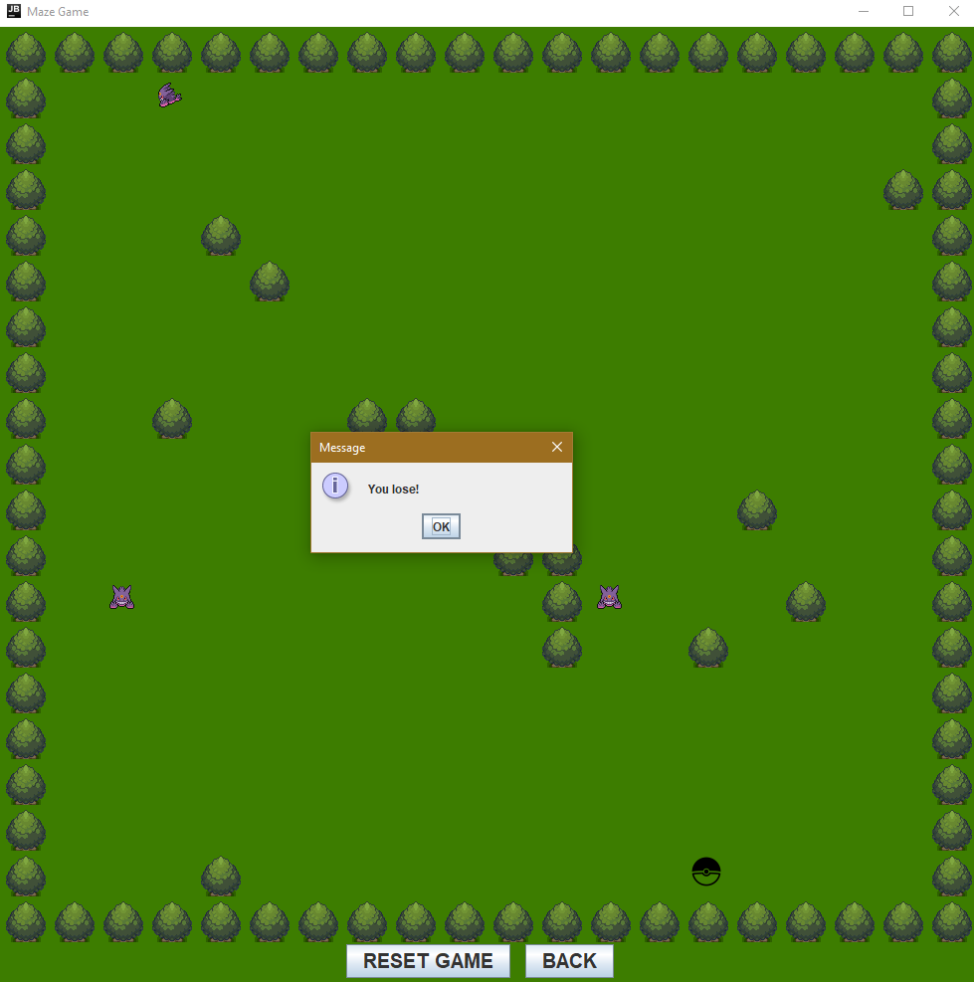
Losing

Slide 11
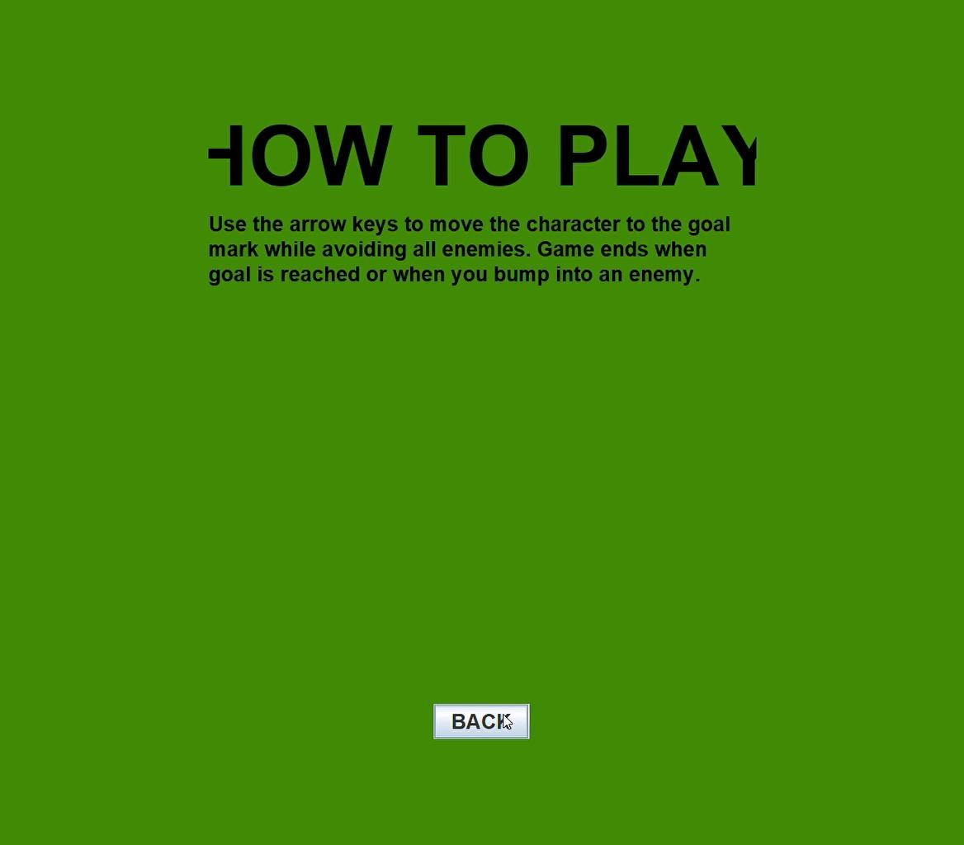
Video of game running

